Slide 1




Designing and Implementing an emotion
monitoring system for children under age 10.
GROUP ID:TPM-2023 - 113
Bachelor of Science (Hons) in Information Technology Specializing in Information Technology
01
20/03/2024

Slide 2
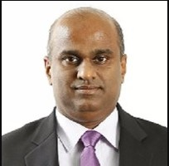
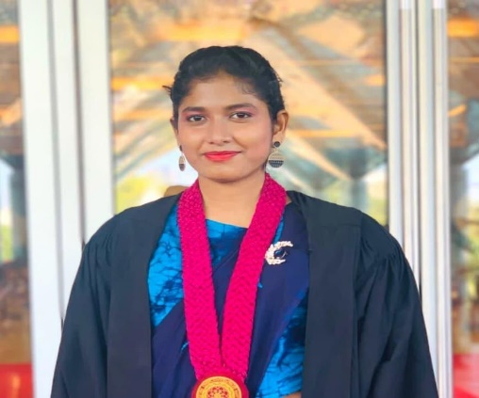
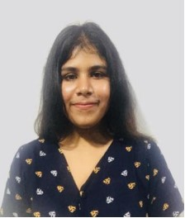
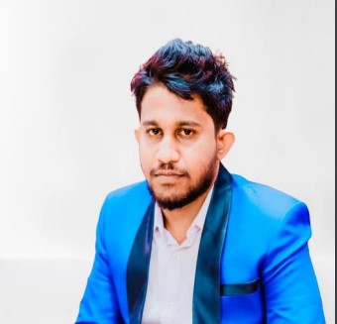
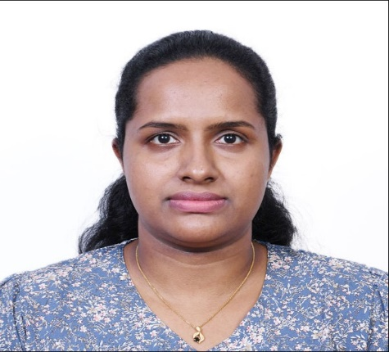
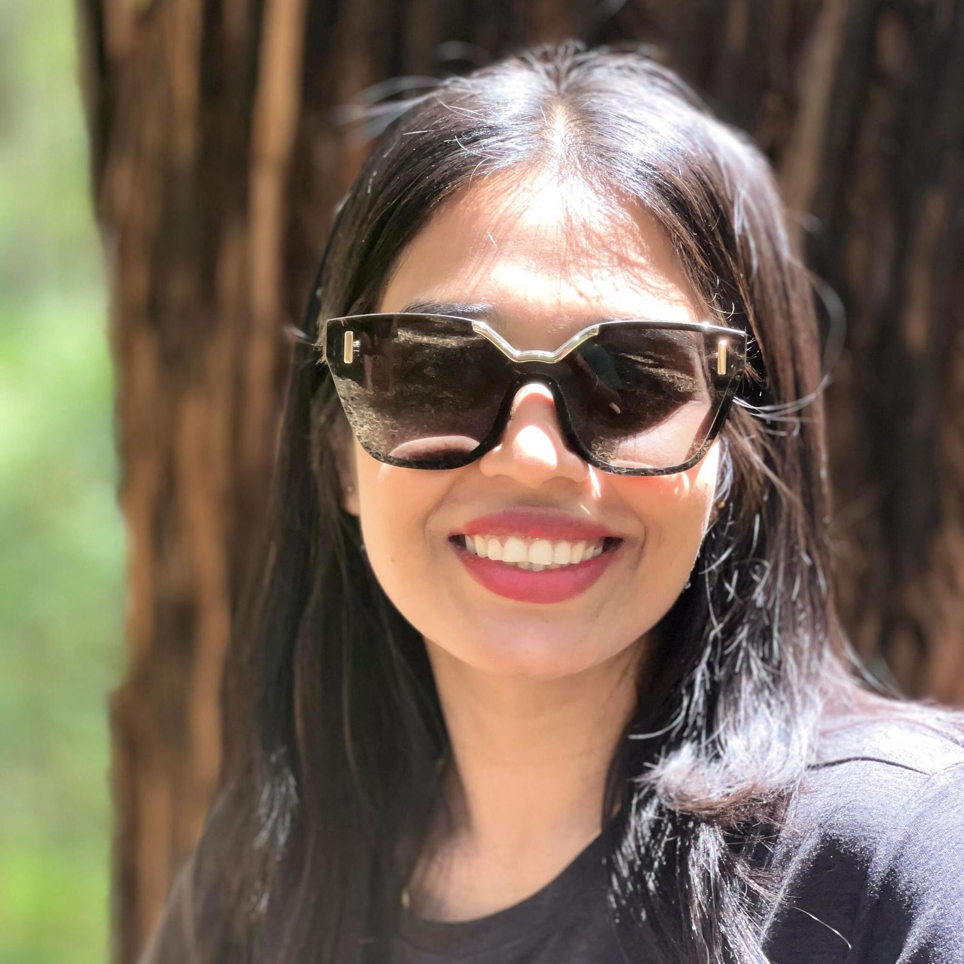
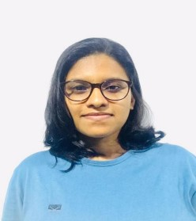
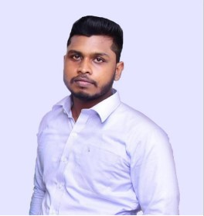
INTERDUCING
Supervisor
Pro. Koliya Pulasinghe
PRESENTED BY
IT20658786 WIJESINGHE M.A.E
Mrs. Pabasara Wijesiriwardana
Speech and Hearing Therapist
IT20666774
GAYASHAN K.L
Co-Supervisor
Ms. Wishalya
Tissera
IT20646042
ABEYWICKRAMA S.A.
Mrs. Linda Senarath
BA ( Psychology)-AUW-Bangladesh
IT20667832
JAYASINGHE H.D.D.P
02
20/03/2024

Slide 3


Slide 4
INTRODUCTION
There are only 40 children in one classroom as the existing educational facilities in Sri Lanka are limited. Among these children, some children receive love and care well in the family environment and have a well-balanced mentality. But the situation of some children is much different than this. They are mentally unstable due to lack of love or care of their parents in the family environment or due to some other social or problem. There is no proper mechanism to identify such children at an early age and it is caused by human resources. We will introduce an application to avoid the problems
03
| | TPM-2023 - 113
20/03/2024

Slide 5
Main Objective
Automating the instruction and methodology issuing procedure to teachers for children under 10 years old with mental health problems.
Sub Objectives
04
| | TPM-2023 - 113
20/03/2024

Slide 6
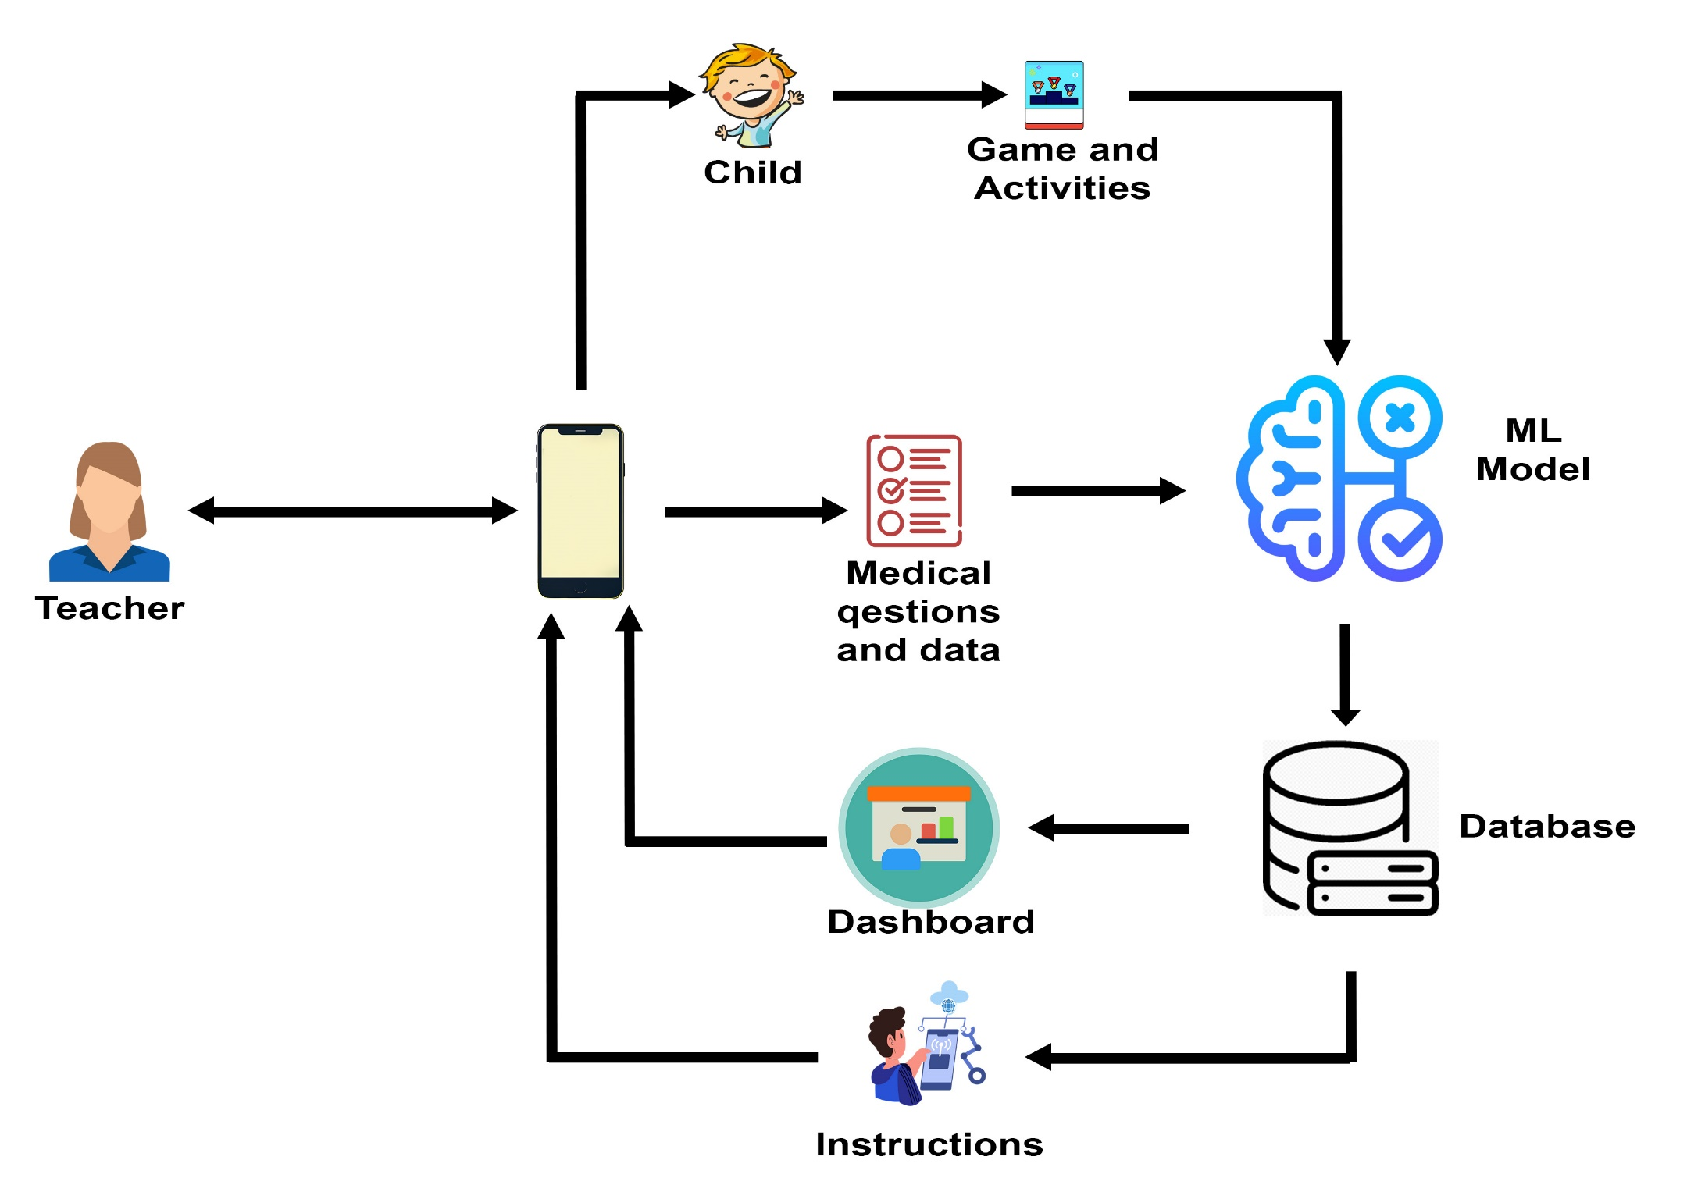
Overall System Diagram
05
| | TPM-2023 - 113
20/03/2024

Slide 7
IT20658786 | WIJESINGHE M.A.E
Bachelor of Science (Hons) in Information Technology Specializing in Information Technology
00
IT20658786 | WIJESINGHE M.A.E| TPM-2023 - 113
20/03/2024

Slide 8
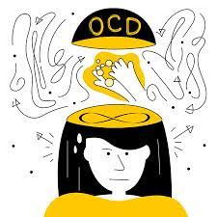


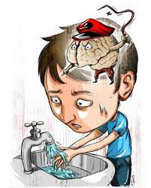
Introduction
Research Question
Are there ways in the world to diagnose OCD in children more quickly and easily without the intervention of a doctor and Can it be detected through a smartphone using modern technology and knowledge?
In the Sri Lankan school system, are there proper methods to identify the mental problems of children at the primary age and are there teachers with the necessary knowledge and ability to do so??
Can mobile game technology provide a solution to OCD in a more engaging way for children?
06
IT20658786 | Wijesinghe M.A.E| 2021 - 042
14/10/2021

Slide 9

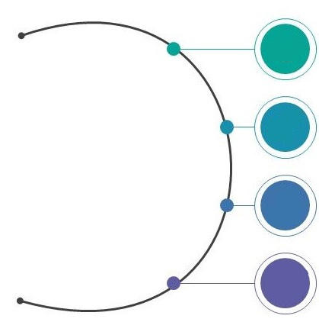





Introduction
Specific and Sub Objective
Finding out if the child has OCD.
Specific Objective
Displaying the level of OCD the child has.
Classification
of
OCD Manager
If the child has symptoms of OCD, provide simple psychological treatment that can be given to the child.
Treating the child's mind using a mobile game played online and giving the child the mental strength needed to face the problem..
18
IT20658786 | Wijesinghe M.A.E| 2021 - 042
14/10/2021

Slide 10
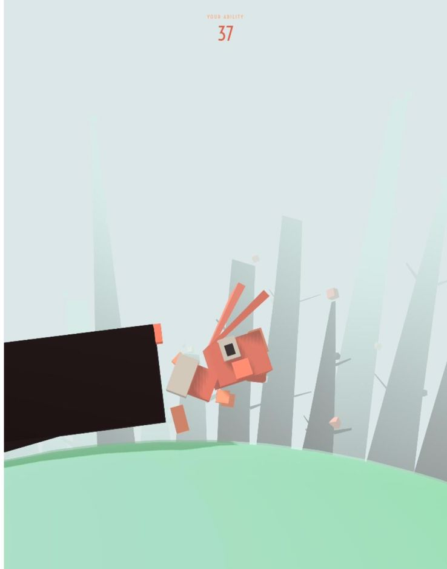
How is OCD Manager different from other apps?
Before the OCD Manager Game only the game called Ricky and the spider was made as a game for Childhood OCD. It is a Cognitive behavioral therapeutic game. It is a game that needs to be paid for and if the child is to play it , the therapist must also participate with the child.
The OCD Manager game can be introduced as a quick solution and a more successful and improved solution. Also, it is unique that it contains simple remedies that can be given to the child by easily identifying whether the child has OCD or not And this is available free of charge. This is very easy for the child to understand and the child will love to play.

Slide 11
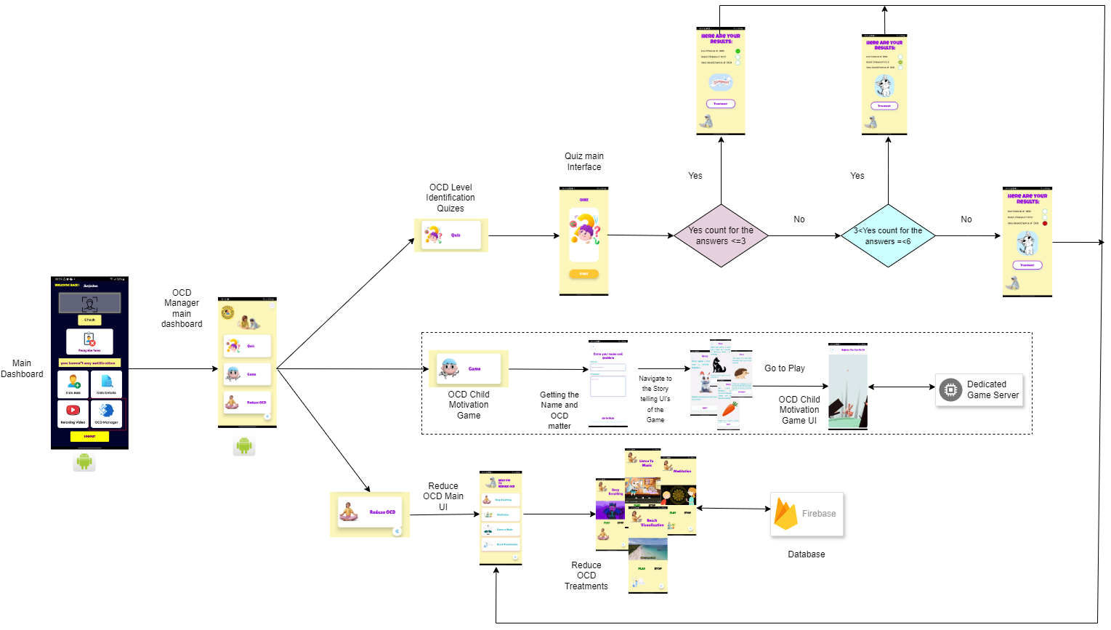
Methodology
System Diagram
Identification and Giving Treatments for the Childhood OCD
19
IT20658786 | Wijesinghe M.A.E| 2021 - 042
14/10/2021

Slide 12

Evidences for Completion
Summary of Sub Objective
Achievement
I developed a successful teacher-administered questionnaire to determine if a child has OCD.
I have presented the child's ocd
condition in 3 levels to make it
more user friendly.
I successfully created a mobile game to teach the child's mind that it has the ability to get rid of harmful thoughts.
Through a Google form and under the supervision of a psychiatrist, I created a dataset containing obsessive thoughts that affect the individual's mind.
I have provided some quick and mind-calming activities accepted by researchers under the treatments category to be given to a child who is always affected by such obsessive thoughts.
44
IT20658786| Wijesinghe M.A.E| 2021 - 042
14/10/2021

Slide 13
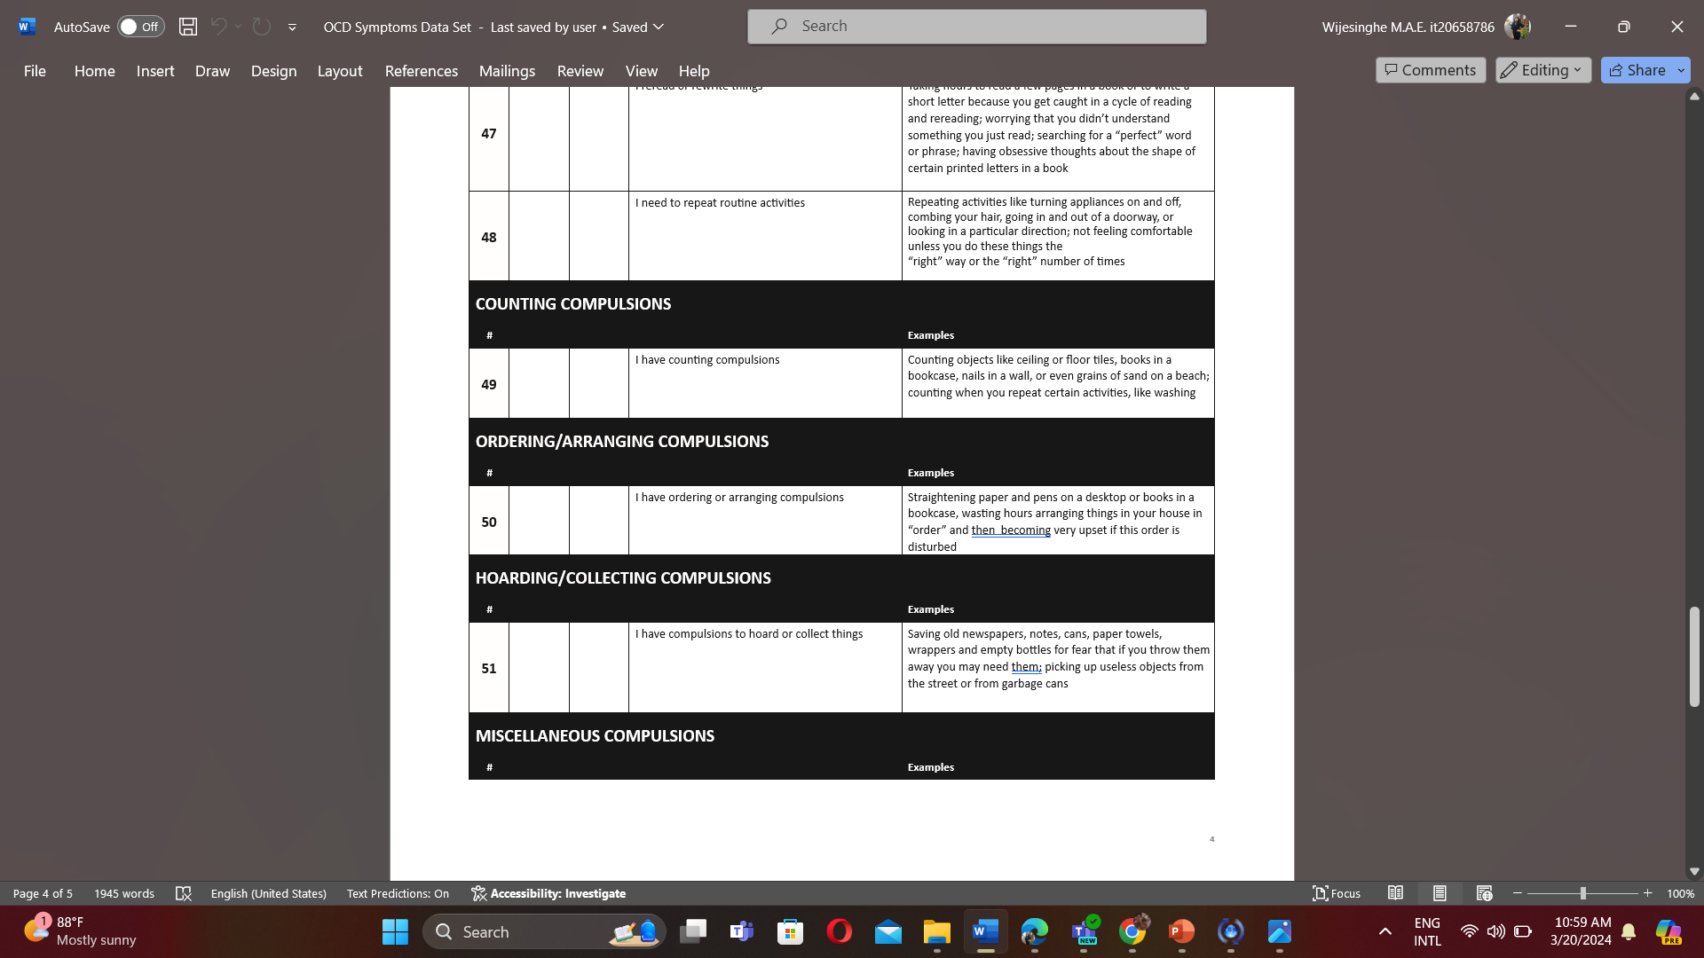
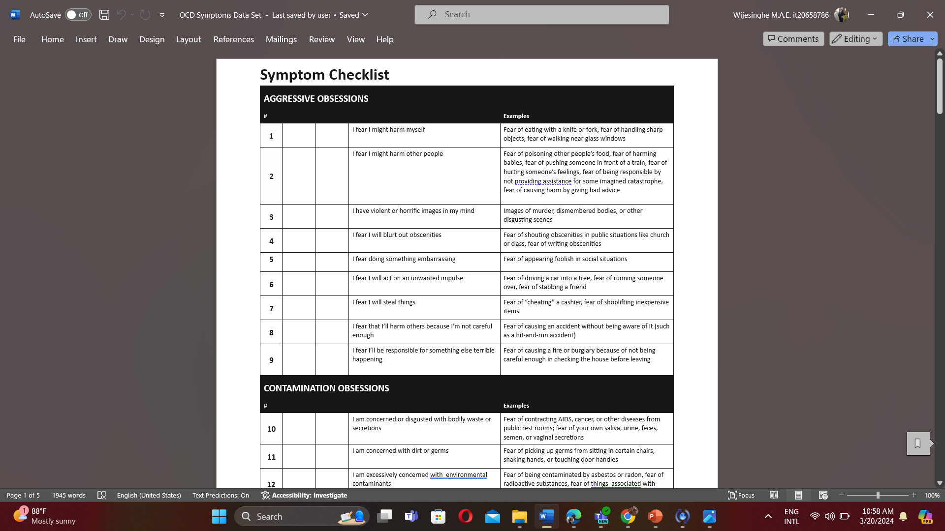
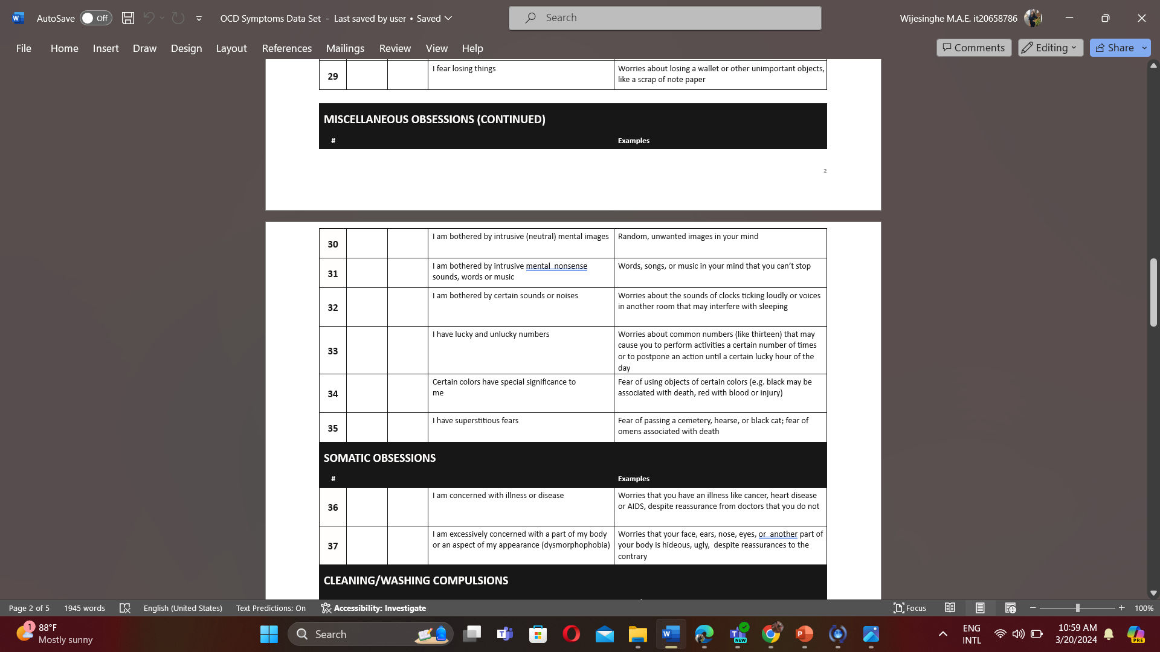
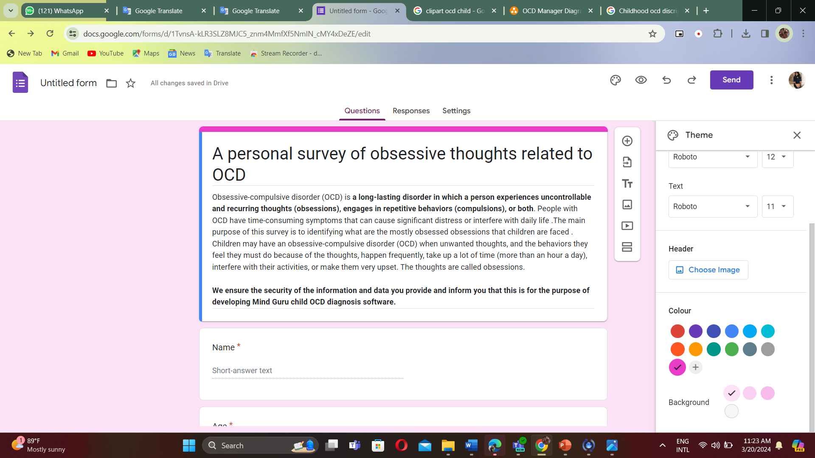
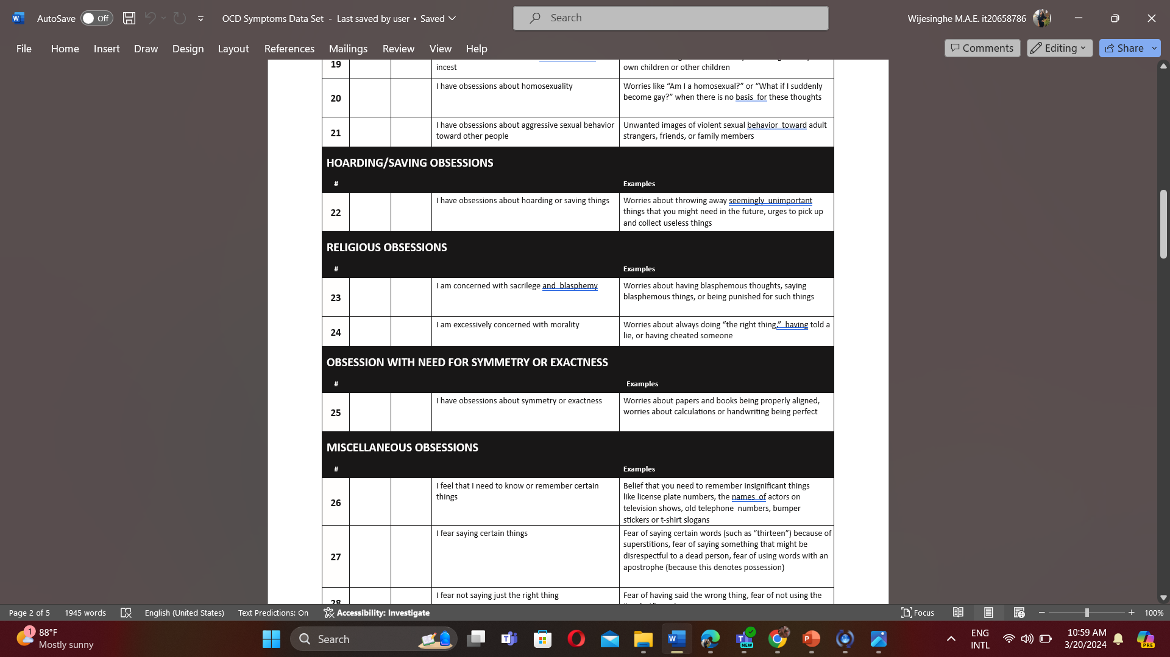
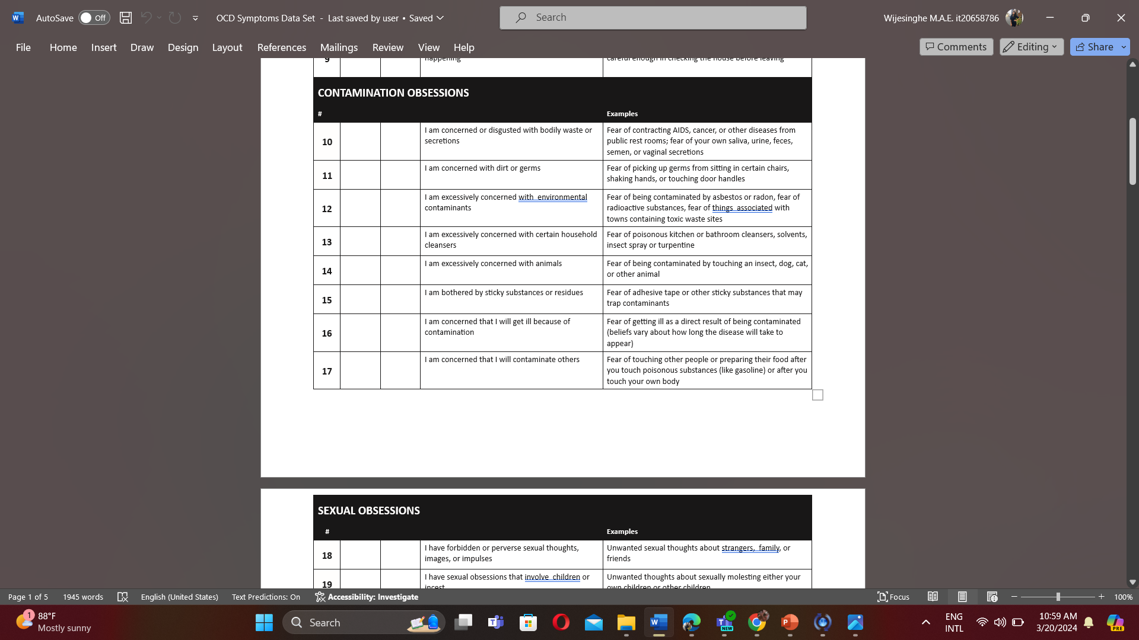
Evidences for Completion
Of Data Gathering
43
IT18051612 | Rajapaksha H.M.U.D | 2021 - 042
14/10/2021

Slide 14
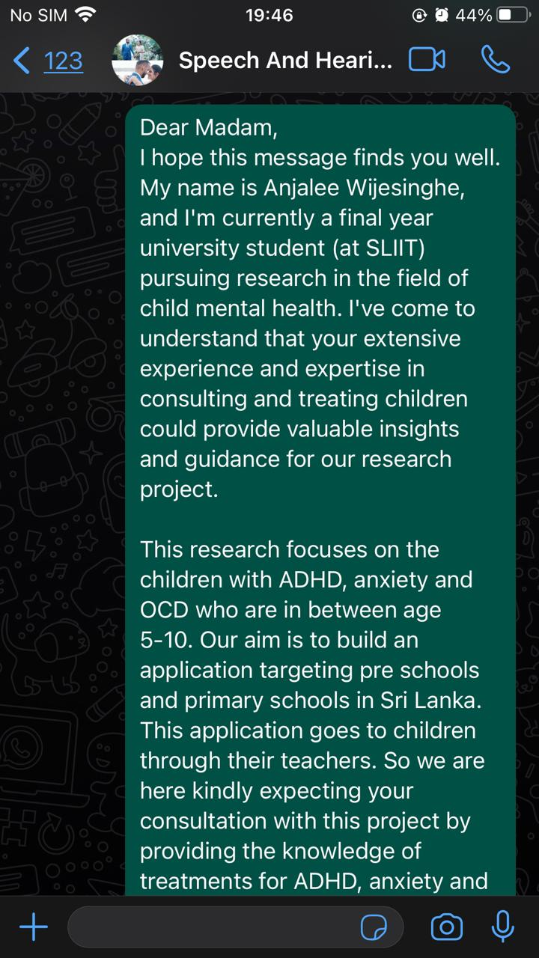
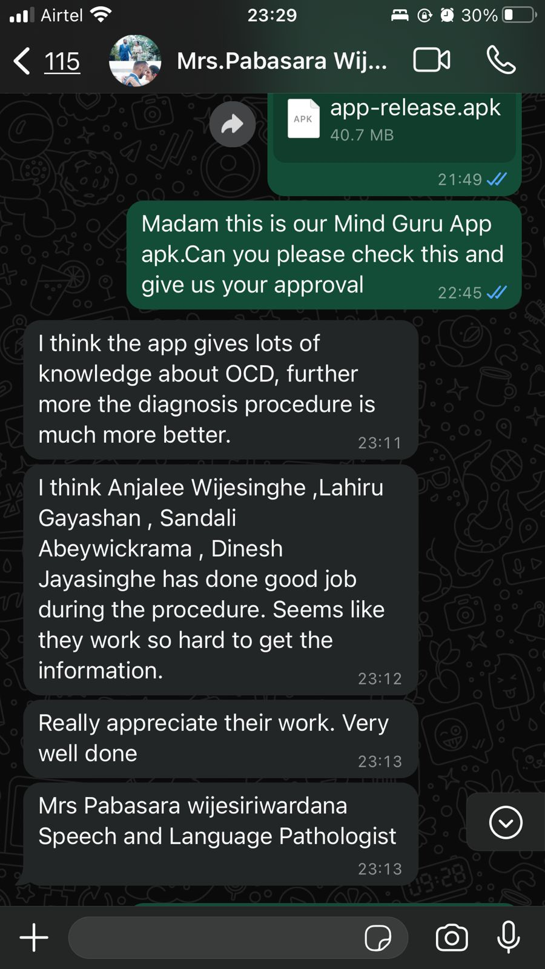
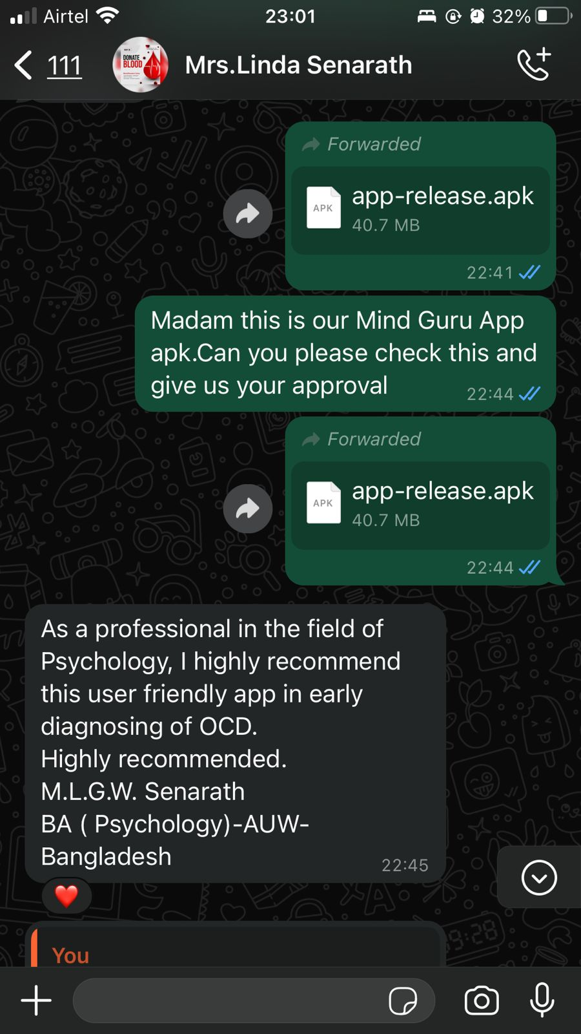
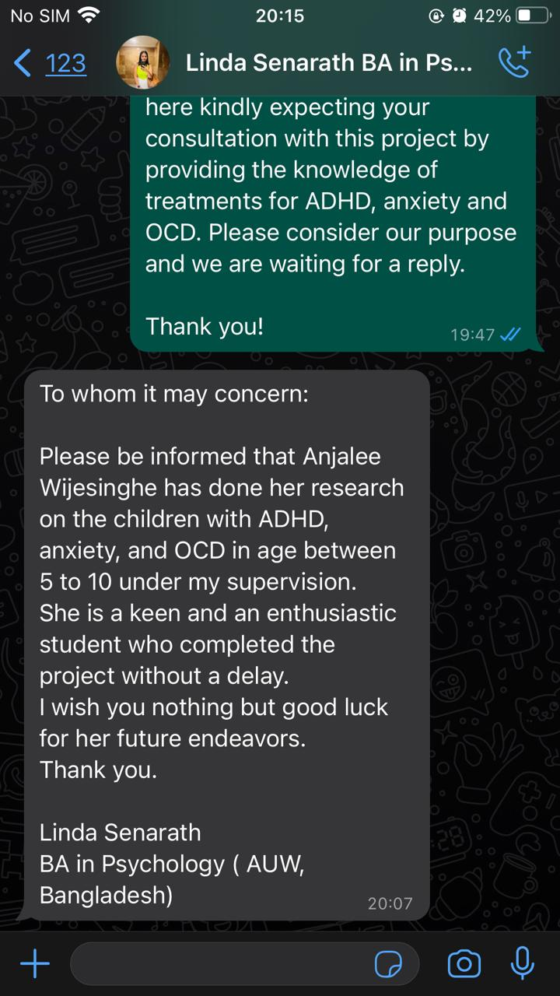
Evidence that the software was developed under the supervision of and certified by those with expertise in pediatric OCD.
Mrs.Pabasara Wijesiriwardenaa
Bsc. Speech and Language Therapy
Mrs.Linda SenarathBA in Psychology ( AUW, Bangladesh)
43
IT20658786 | Wijesinghe M.A.E| 2021 - 042
14/10/2021

Slide 15
IT20666774 | Gayashan K.L
Bachelor of Science (Hons) in Information Technology Specializing in Information Technology
00
IT20666774 | Gayashan K.L | TPM-2023 - 113
20/03/2024

Slide 16

Introduction
Research Question
"How to provide instructions and procedures to direct primary teachers to handle ADHD, OCD and anxiety of children’s under 10 years old since that is the most important development phase of a healthy person?”
00
IT20666774 | Gayashan K.L | TPM-2023 - 113
20/03/2024

Slide 17
IT20646042 | ABEYWICKRAMA S.A.
Bachelor of Science (Hons) in Information Technology Specializing in Information Technology
00
IT20646042 | ABEYWICKRAMA S.A. | TPM-2023 - 113
20/03/2024

Slide 18

RESEARCH PROBLEM
"How can primary teachers be instructed and guided in effectively managing ADHD, a prevalent mental health challenge among children under 10 years old, recognizing its significance during this critical developmental phase?”
"What small activities or strategies would you employ to identify and address the emotions depicted on a child's face, aiming to help them return to a state of emotional equilibrium?
IT20646042 | Abeywickrama S.A. | TPM-2023 - 113
20/03/2024

Slide 19


RESEARCH GAP
System | Research A [3] | Research B [4] | Research C [5] | Research D [6] | Proposed Solution
Provides instructions and methodologies to teachers who engaged with children under 10 years old.
Provides specific therapy methods filtered according to the relevant mental condition.
Differ of the therapy methods when the condition normalizing.
Usage of the most accurate and efficient methodologies rather than just a common activity.
For children between age 5 - 10
"What small activities or strategies would you employ to identify and address the emotions depicted on a child's face, aiming to help them return to a state of emotional equilibrium?
IT20646042 | Abeywickrama S.A. | TPM-2023 - 113
20/03/2024

Slide 20
MAIN OBJECTIVE
"Incorporate a feature into the app offering educational resources, articles, and manuals specifically addressing ADHD, aimed at fostering understanding and support for children's mental health needs."
SUB OBJECTIVES
Create a user-friendly and intuitive interface that is easy for
users to view and engage with.
Identify and extract key factors and activities from the child's
environment that can be used to promote positive mental health
and well-being.
Evaluate the performance of instructions and methodologies
issuing procedure using appropriate metrics like accuracy,
precision, recall, and user satisfaction.
IT20646042 | Abeywickrama S.A. | TPM-2023 - 113
20/03/2024

Slide 21
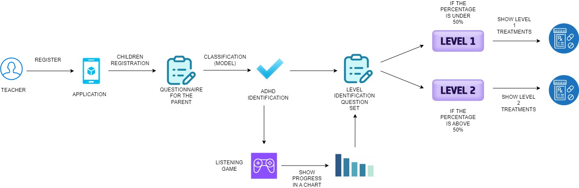
SYSTEM DIAGRAM
IT20646042 | Abeywickrama S.A. | TPM-2023-113
20/03/2024

Slide 22
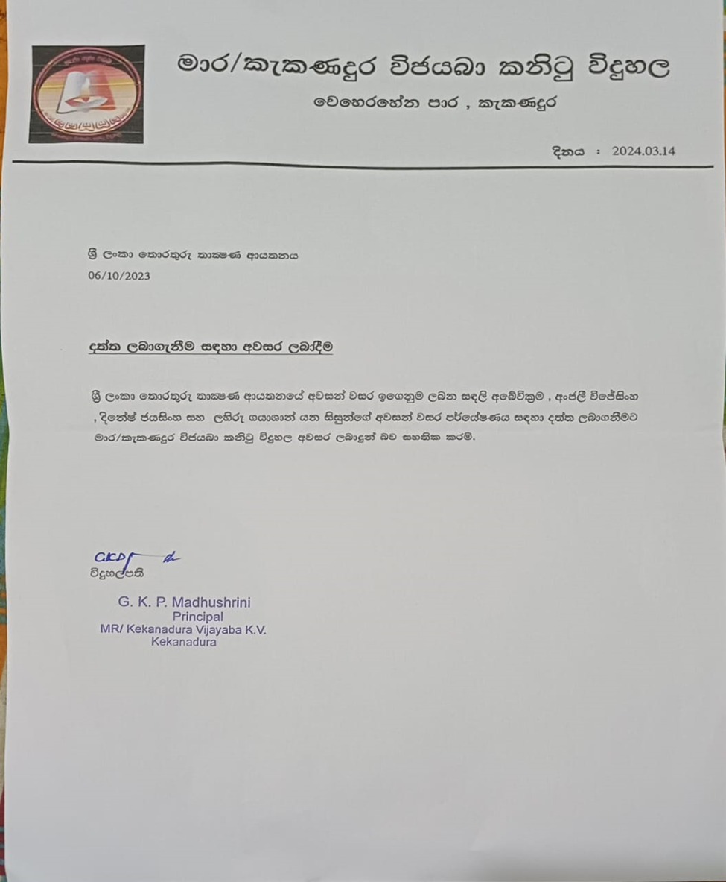
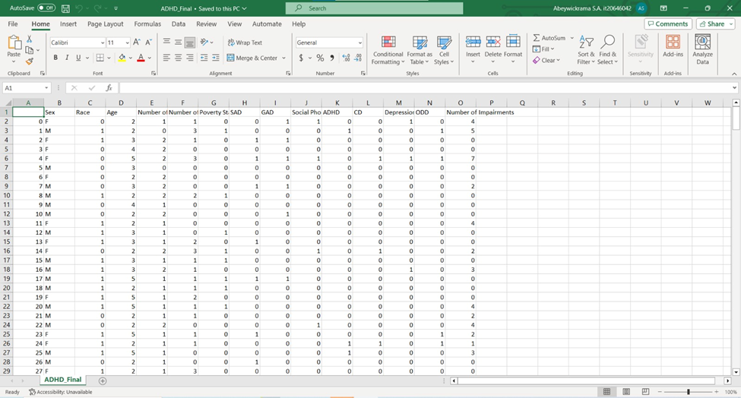
DATA COLLECTION
IT20646042 | Abeywickrama S.A. | TPM-2023-113
20/03/2024

Slide 23
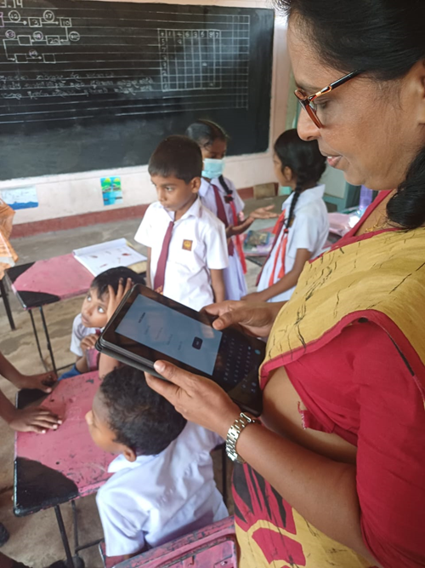
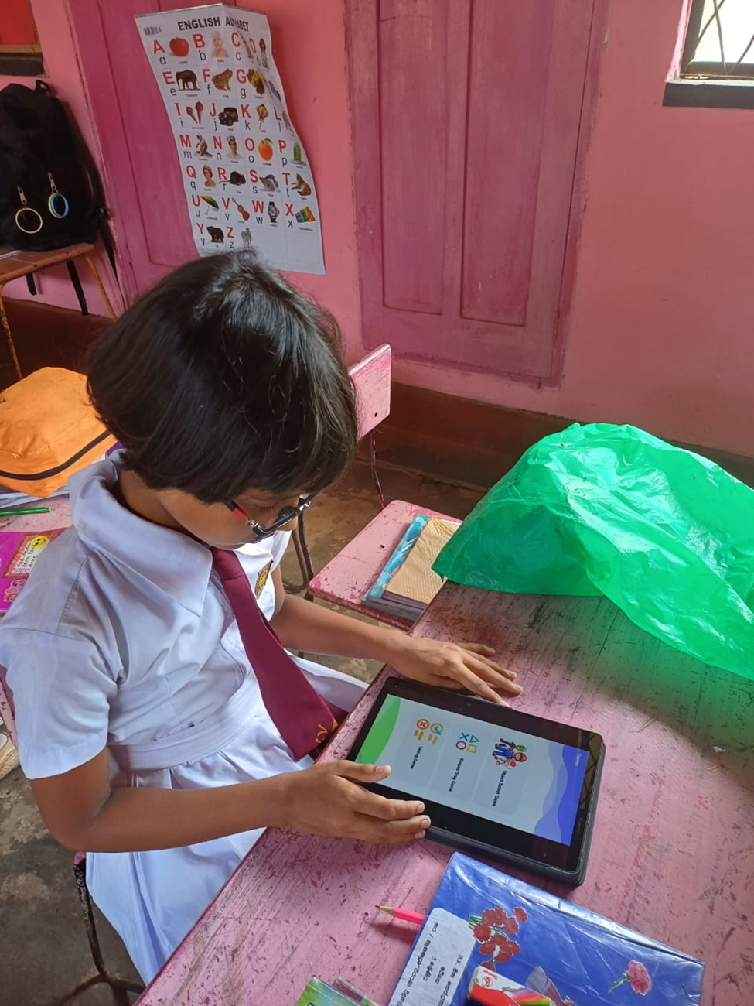
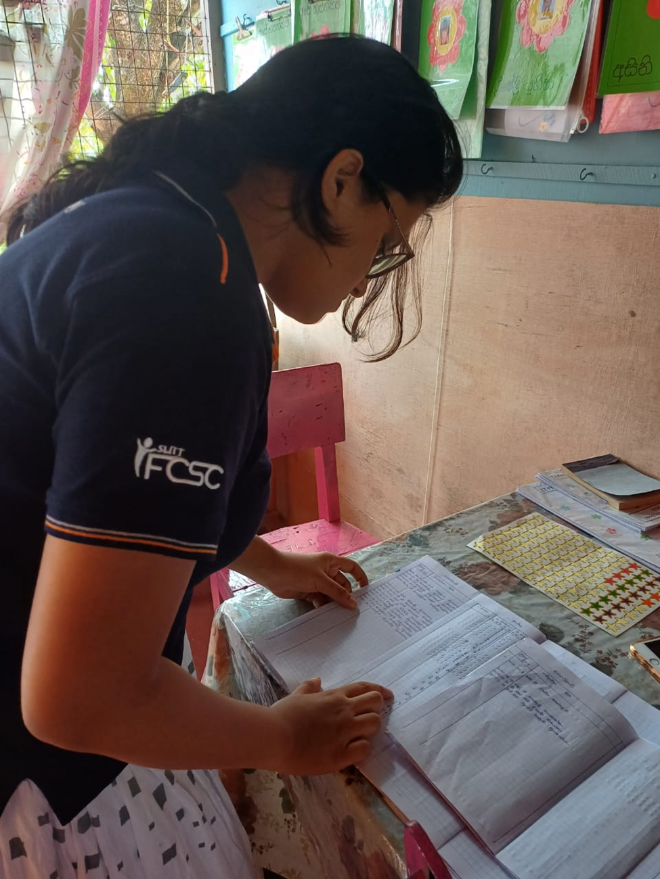
DATA COLLECTION
IT20646042 | Abeywickrama S.A. | TPM-2023-113
20/03/2024

Slide 24
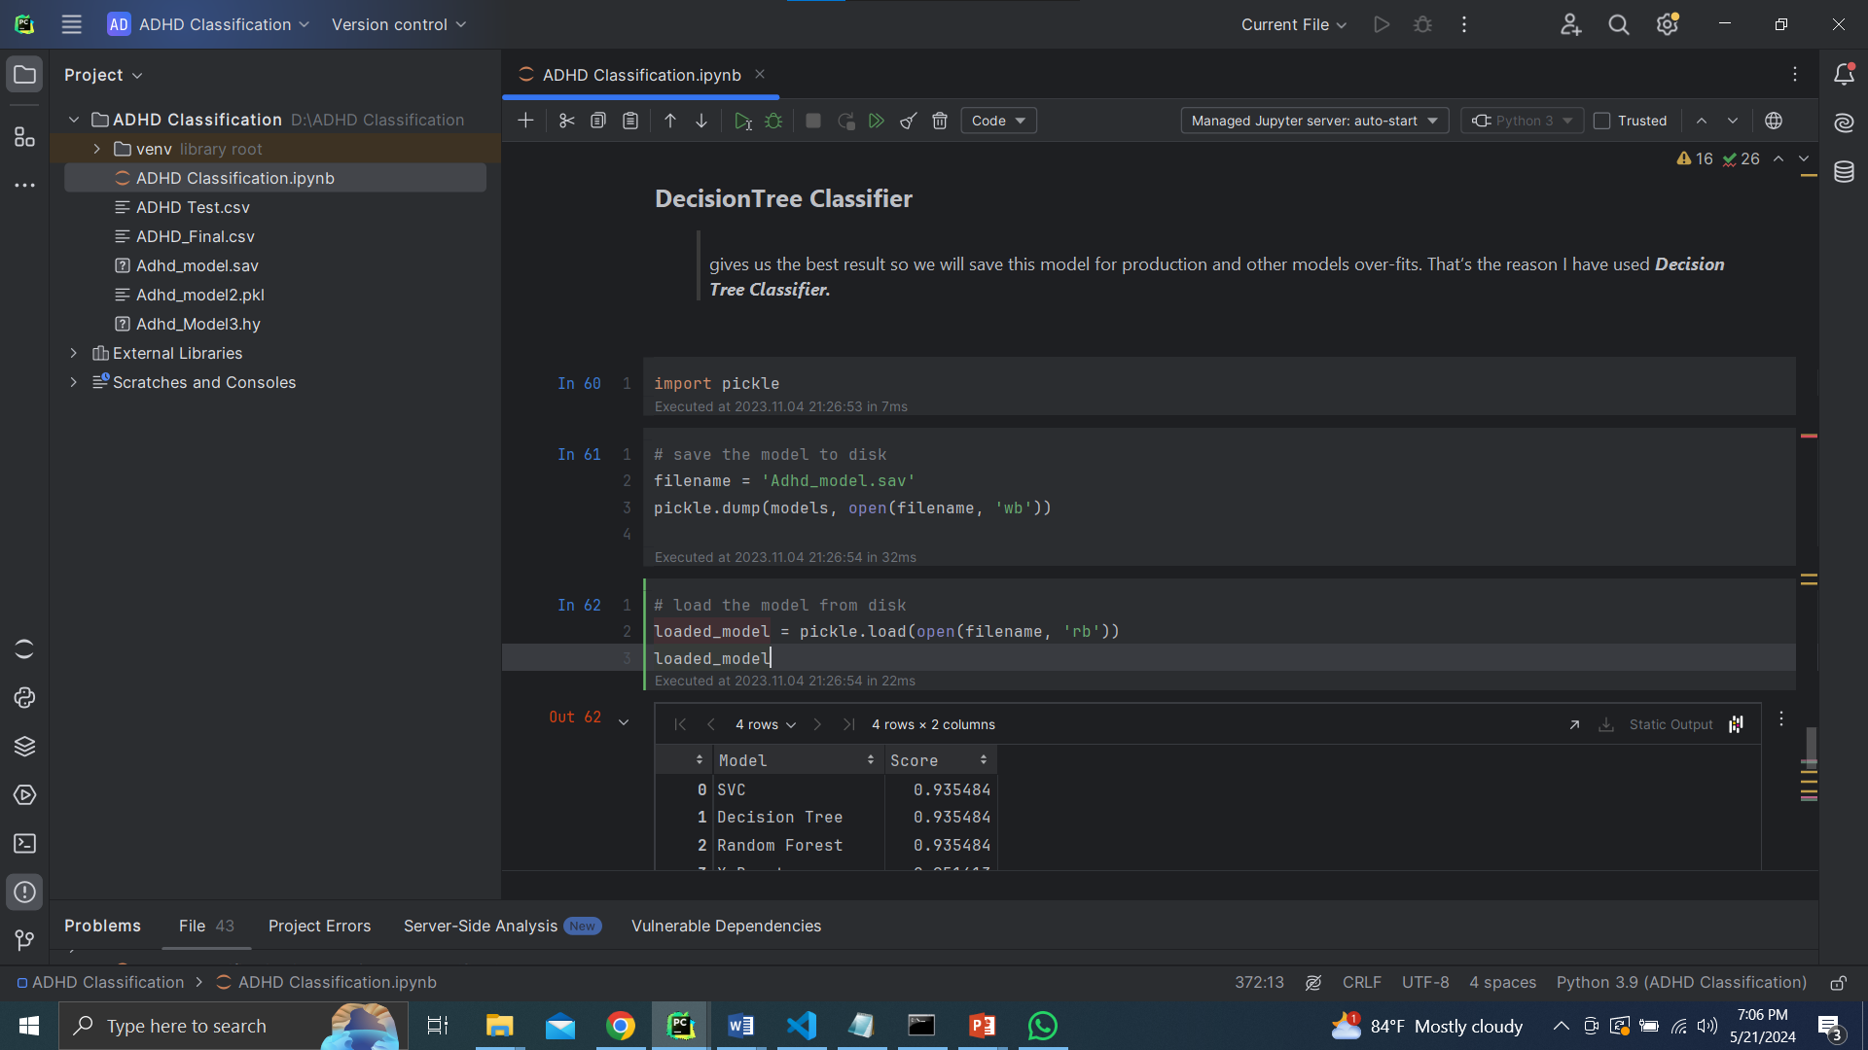
MODEL FOR PREDICTIONS
IT20646042 | Abeywickrama S.A. | TPM-2023-113
20/03/2024

Slide 25
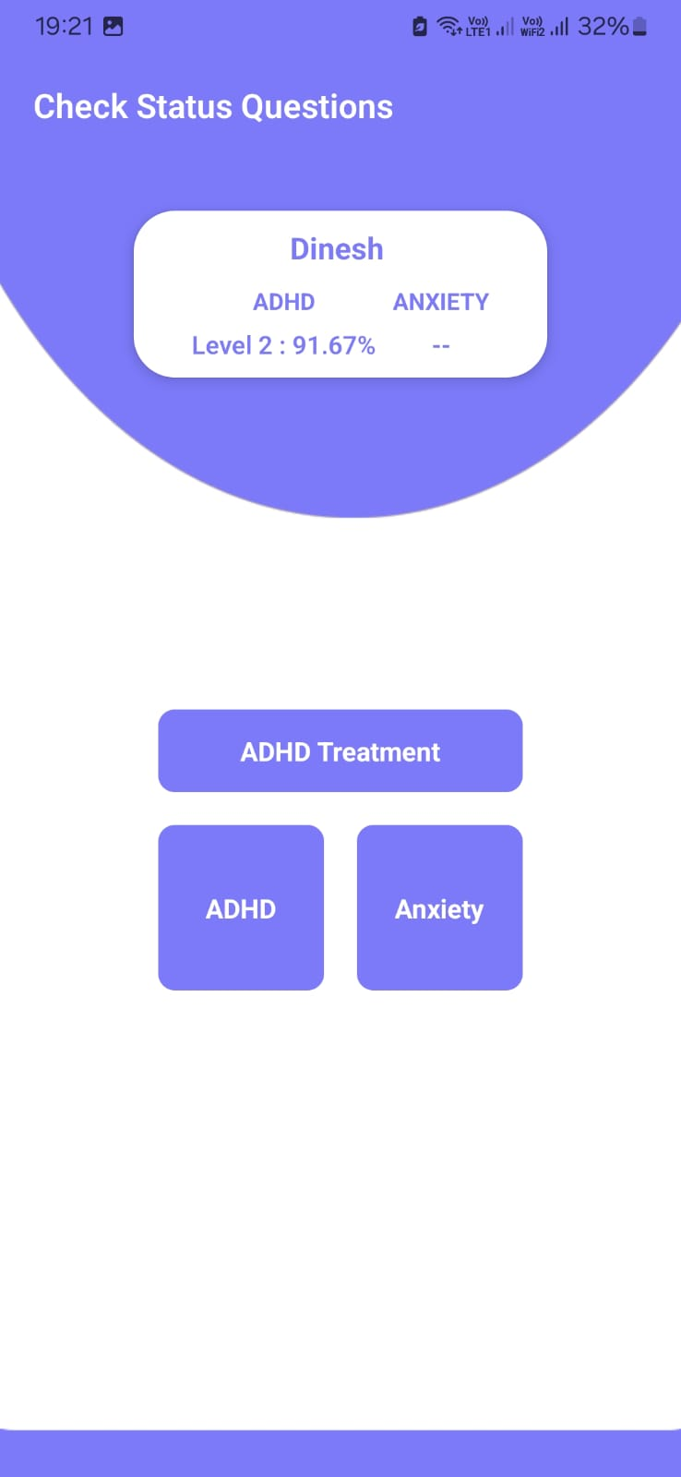
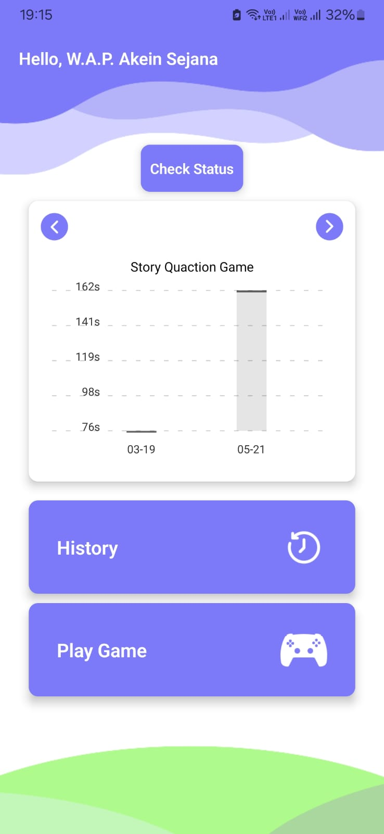
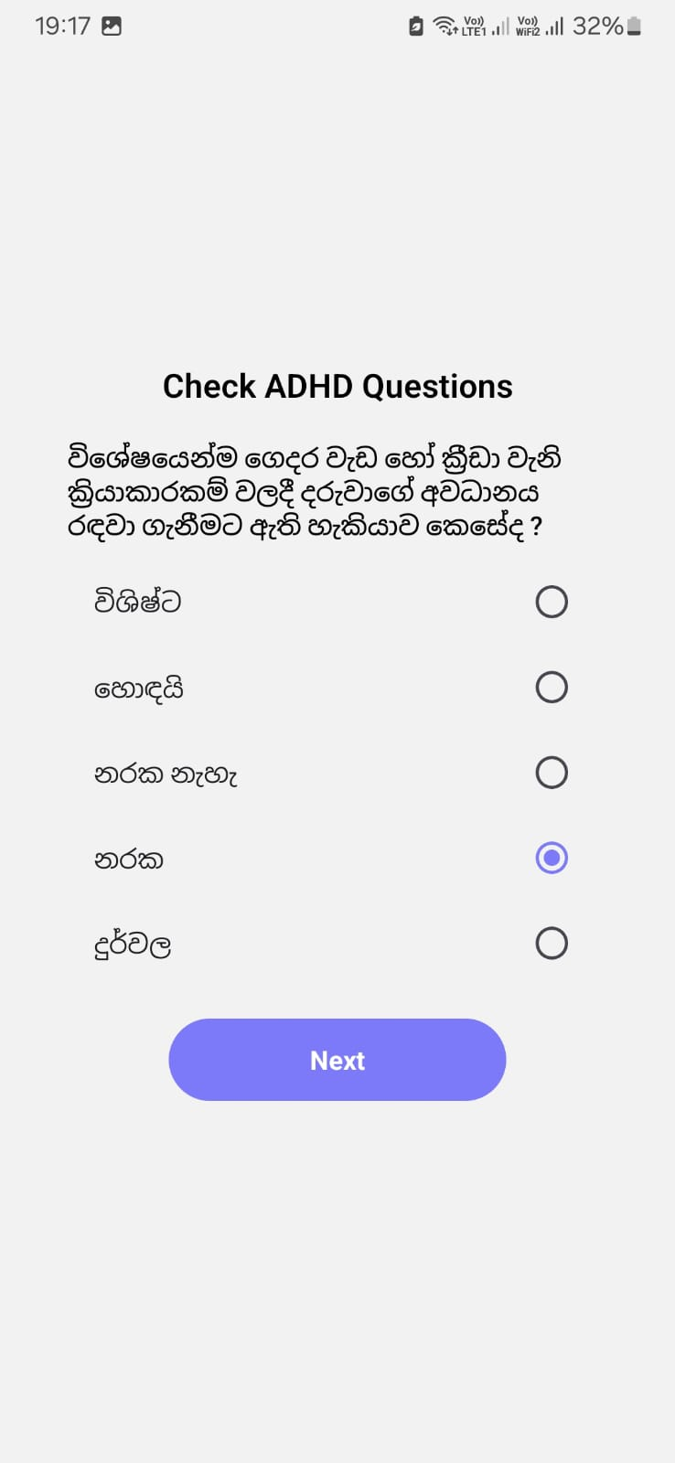
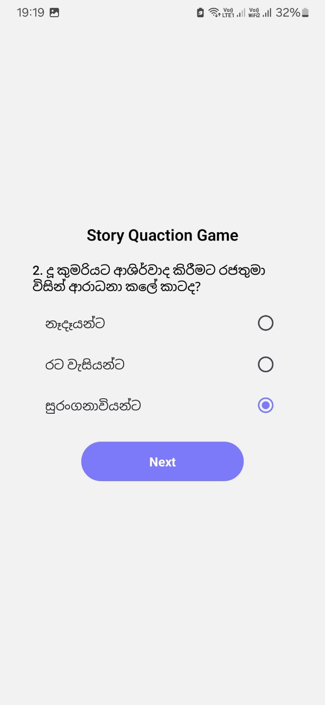
UI RELATED TO ADHD COMPONENT
IT20646042 | Abeywickrama S.A. | TPM-2023-113
20/03/2024

Slide 26
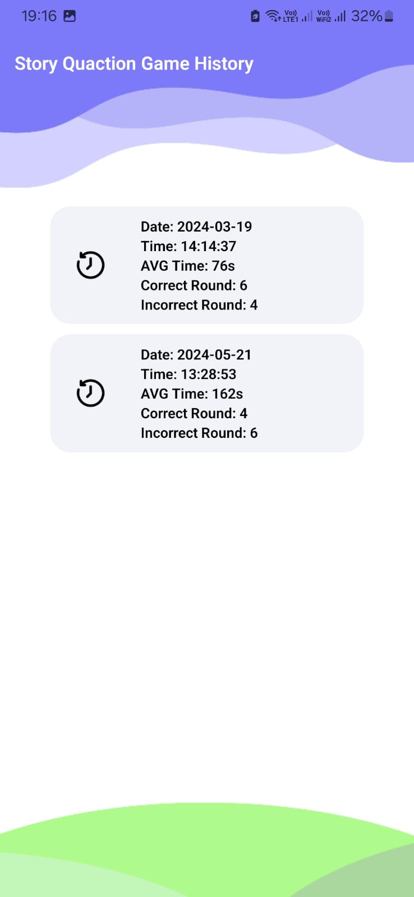
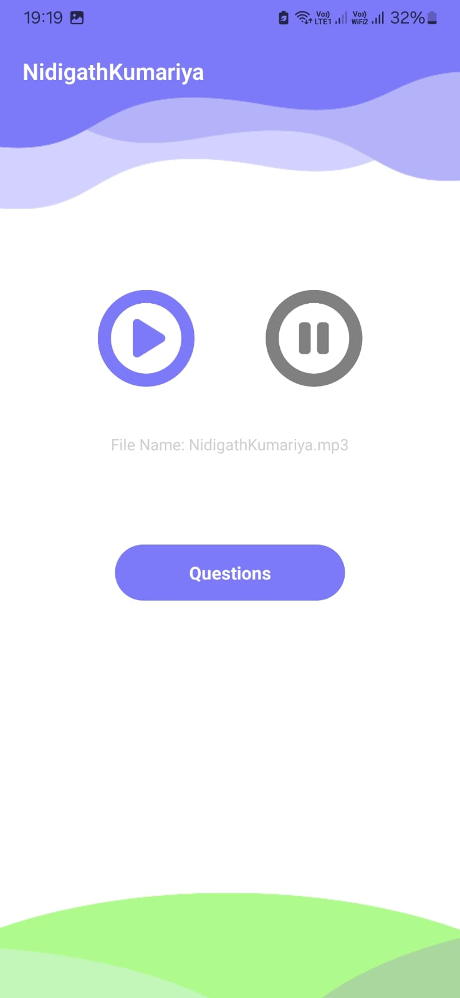
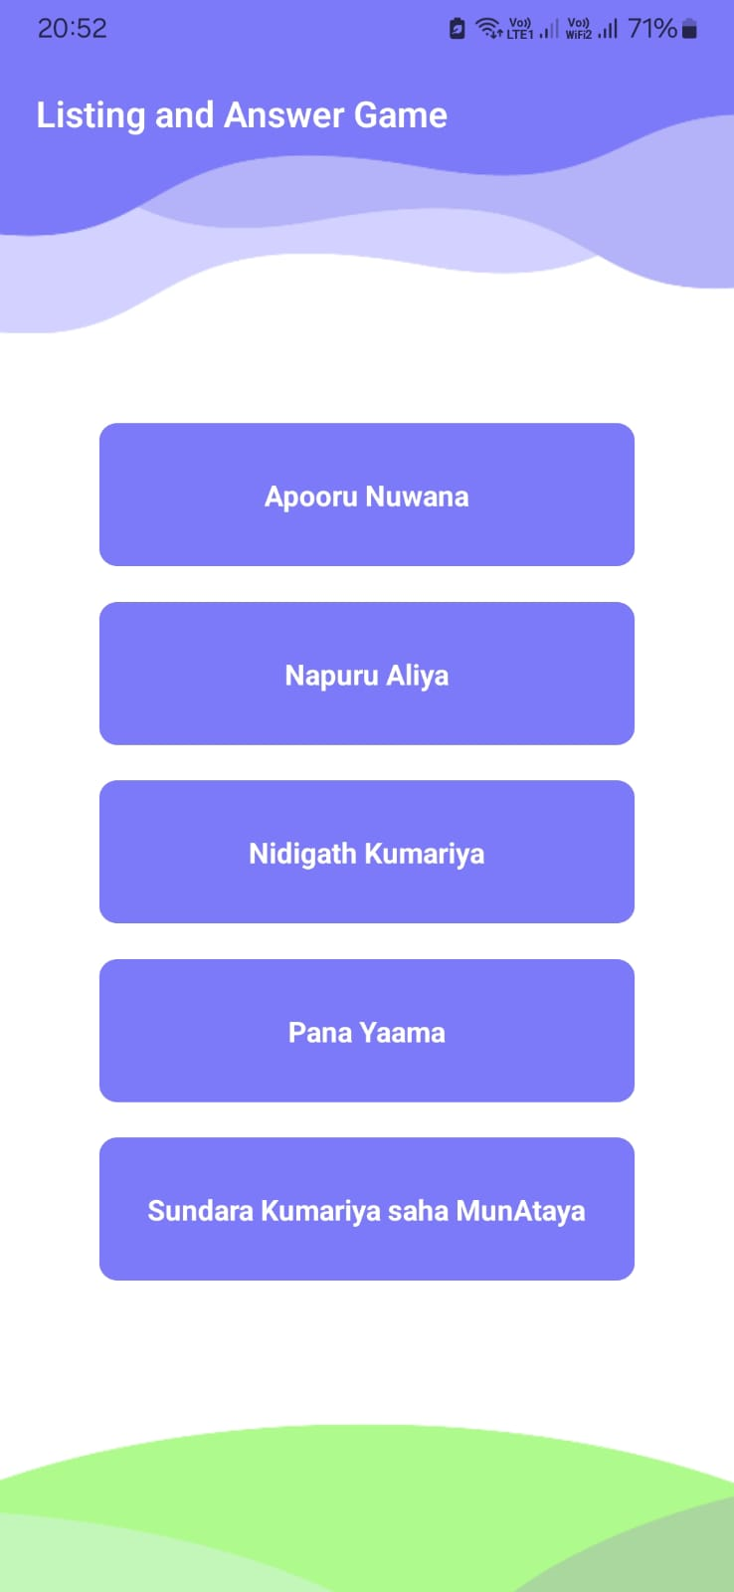
UI RELATED TO ADHD COMPONENT
IT20646042 | Abeywickrama S.A. | TPM-2023-113
20/03/2024

Slide 27
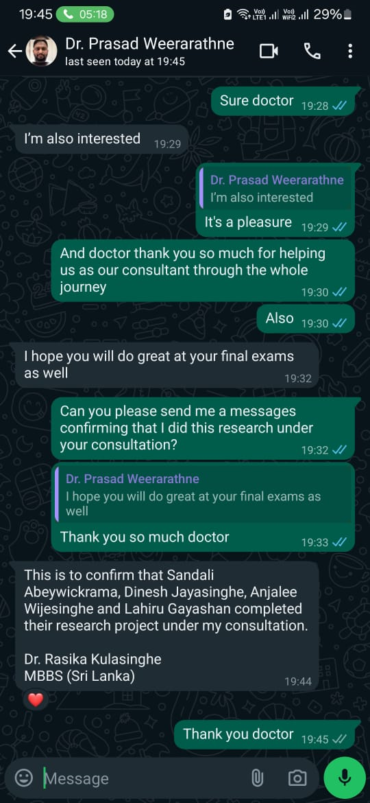
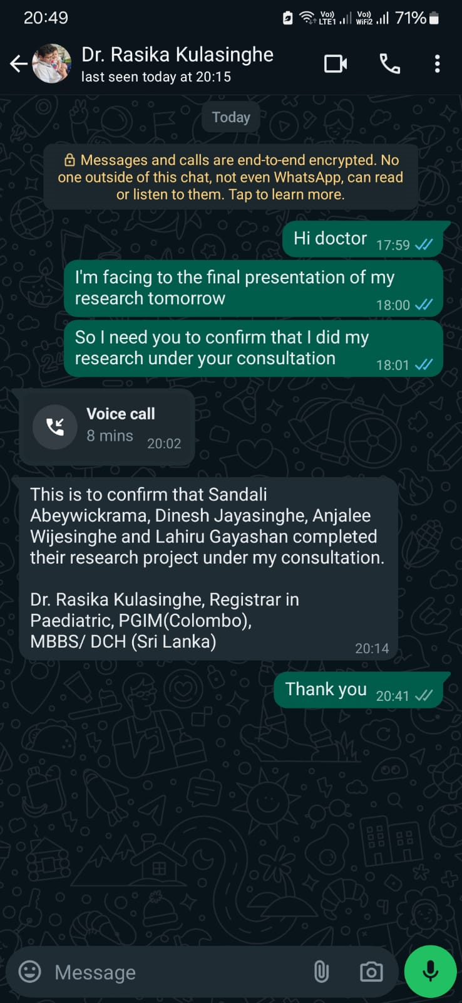
DOCTORS CONFIRMATION
IT20646042 | Abeywickrama S.A. | TPM-2023-113
20/03/2024

Slide 28
IT20667832|JAYASINGHE H.D.D.P
Bachelor of Science (Hons) in Information Technology Specializing in Information Technology
00
IT20667832 | JAYASINGHE H.D.D.P| TPM-2023 - 113
20/03/2024

Slide 29
Main Objective
Identifying if a child under 10 has anxiety and analyzing and identifying children's progress
Sub Objective
Creating a questionnaire to collect data from kids; asking the special questions from teachers and parents to identify the decoder level
Develop the dashboard to view the progress of children’s and analyze the decoder level
Develop the game for clam down to children and collect the data.
00
IT20667832 | JAYASINGHE H.D.D.P| TPM-2023 - 113
20/03/2024

Slide 30
Methodology
Select the best method for Data gathering.
Create the special question for identify the decoder using medical requirements.
Develop mobile application and display results in the mobile application.
00
IT20667832 | JAYASINGHE H.D.D.P| TPM-2023 - 113
20/03/2024

Slide 31
PROGRESS
Current Progress
Develop the special questionnaire for teachers to get idea about child status level.
Develop the dashboard for present current situation and percentage.
Develop the game for children to calm down and collect to data.
Future Implementations
improve the games in use
improve the visualization & dashboard to represent the more accurate progress
Trine the most accurate model to get the prediction
Finally,integrateallthecomponentsandmaketheresultavailablethroughtheMobile application
00
IT20667832 | JAYASINGHE H.D.D.P| TPM-2023 - 113
20/03/2024

Slide 32
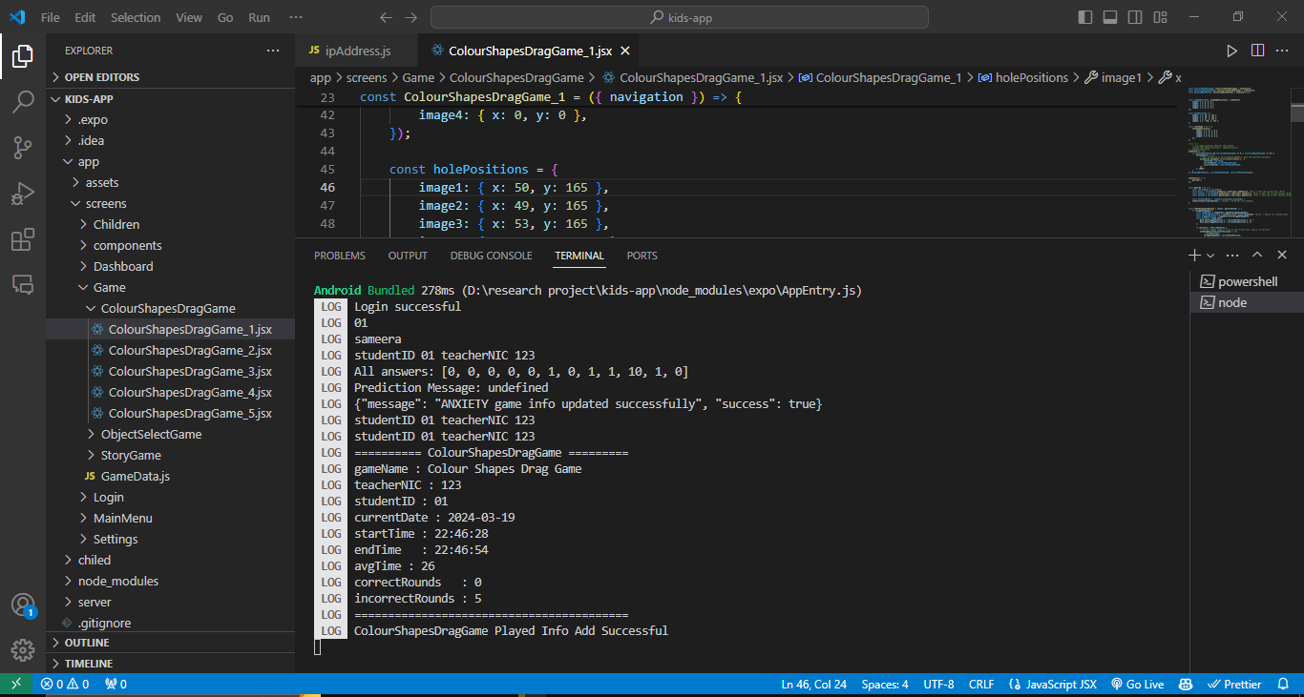
Achievements
00
IT20667832 | JAYASINGHE H.D.D.P| TPM-2023 - 113
20/03/2024

Slide 33
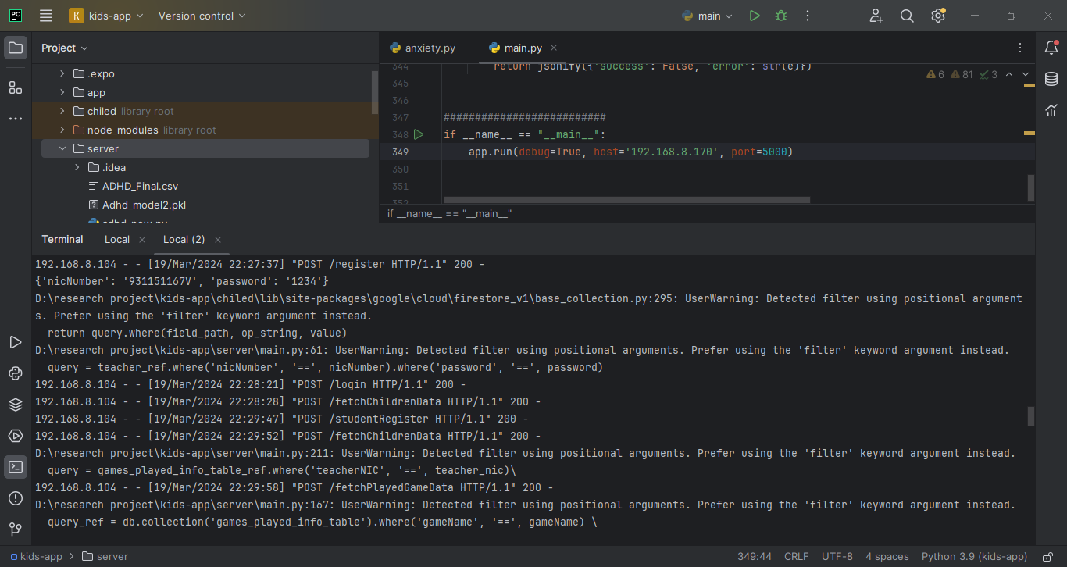
Achievements
00
IT20667832 | JAYASINGHE H.D.D.P| TPM-2023 - 113
20/03/2024

Slide 34

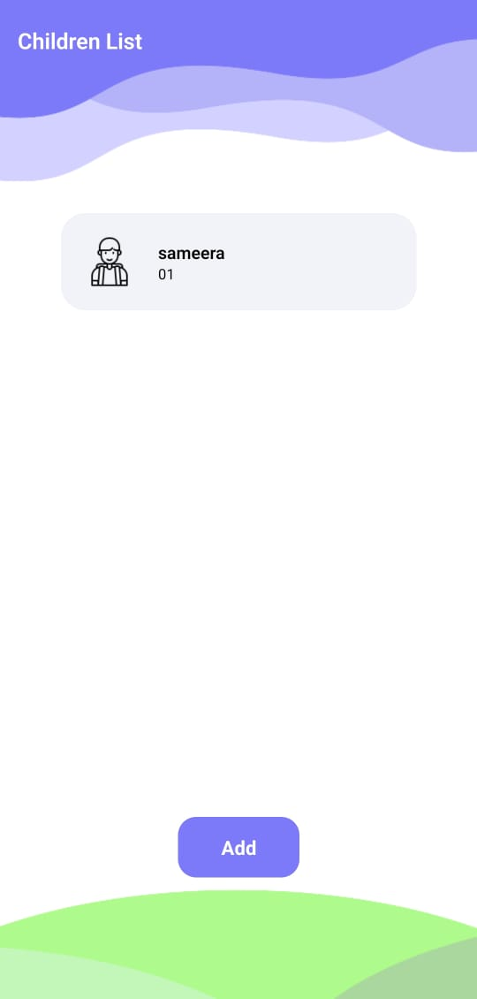
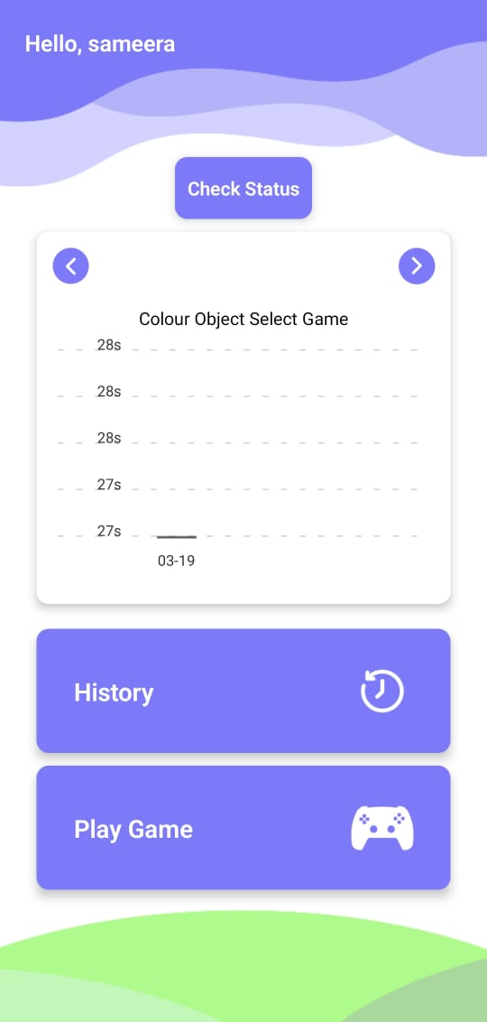
Achievements
00
IT20667832 | JAYASINGHE H.D.D.P | TPM-2023 - 113
20/03/2024

Slide 35
Project Evidence
B. Thapaliya, V. D. Calhoun and J. Liu, "Environmental and genome-wide association study on children anxiety and depression," 2021 IEEE International Conference on Bioinformatics and Biomedicine (BIBM), Houston, TX, USA, 2021, pp. 2330-2337, doi: 10.1109/BIBM52615.2021.9669291. keywords: {Computational modeling;Atmospheric modeling;Anxiety disorders;Sociology;Genomics;Depression;Brain modeling;Anxiety;Depression;Linear Mixed Models;Recursive Feature Elimination;Lasso Regression;Genome-wide Association Study;Heritability},
R. F. L. Trujillo, N. M. G. Santos and J. Armas-Aguirre, "Technological solution of psychological therapies using neural networks for the control and monitoring of anxiety disorder," 2021 IEEE Sciences and Humanities International Research Conference (SHIRCON), Lima, Peru, 2021, pp. 1-4, doi: 10.1109/SHIRCON53068.2021.9652260. keywords: {Conferences;Neural networks;Anxiety disorders;Sociology;Medical treatment;Mental health;Real-time systems;Anxiety Disorder;Monitoring System;Children;Neural Network;Symptom Collection},
00
IT20667832 | JAYASINGHE H.D.D.P | TPM-2023 - 113
20/03/2024

Slide 36
Project Evidence
[2] - B. C. Loftness, J. Halvorson-Phelan, A. O'Leary, N. Cheney, E. W. McGinnis and R. S. McGinnis, "UVM KID Study: Identifying Multimodal Features and Optimizing Wearable Instrumentation to Detect Child Anxiety," 2022 44th Annual International Conference of the IEEE Engineering in Medicine & Biology Society (EMBC), Glasgow, Scotland, United Kingdom, 2022, pp. 1141-1144, doi: 10.1109/EMBC48229.2022.9871090. keywords: {Pediatrics;Sensor placement;Tracking;Anxiety disorders;Redundancy;Point of care;Mental health;digital medicine;anxiety;depression;wearable sensors;signal processing;pediatric mental health},
[3]-B. C. Loftness, J. Halvorson-Phelan, A. O'Leary, N. Cheney, E. W. McGinnis and R. S. McGinnis, "UVM KID Study: Identifying Multimodal Features and Optimizing Wearable Instrumentation to Detect Child Anxiety," 2022 44th Annual International Conference of the IEEE Engineering in Medicine & Biology Society (EMBC), Glasgow, Scotland, United Kingdom, 2022, pp. 1141-1144, doi: 10.1109/EMBC48229.2022.9871090. keywords: {Pediatrics;Sensor placement;Tracking;Anxiety disorders;Redundancy;Point of care;Mental health;digital medicine;anxiety;depression;wearable sensors;signal processing;pediatric mental health},
00
IT20667832 | JAYASINGHE H.D.D.P | TPM-2023 - 113
20/03/2024

